Slide 1
Pythonic Package Development
We’ll go through the components together
You will
Clone the example repository https://github.com/wesleybeckner/truffletopia
And use the directory structure as well as the files to create your own project
My suggestion is to copy these files into your own project one by one and make the indicated changes
Need to change field/name
Need to change through GUI/IDE

Slide 2
https://packaging.python.org/tutorials/packaging-projects/

Slide 3
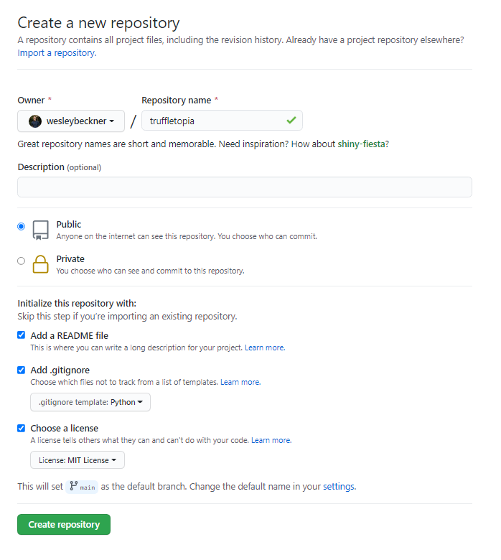
After creating a github account, make a new repository. If you are using company data you will want to choose private, and an appropriate license.
Other settings: include a README and add a .gitignore for python

Slide 4
Structure
├── LICENSE
├── README.md
├── examples
├── truffletopia.ipynb
├── requirements.txt
├── setup.py
└── truffletopia
├── __init__.py
├── data
├── operations.csv
├── tuffletopia.py
└── version.py
https://docs.python-guide.org/writing/structure/

Slide 5
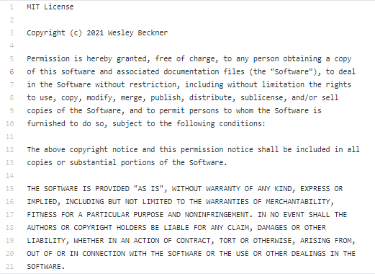
License
https://choosealicense.com/

Slide 6
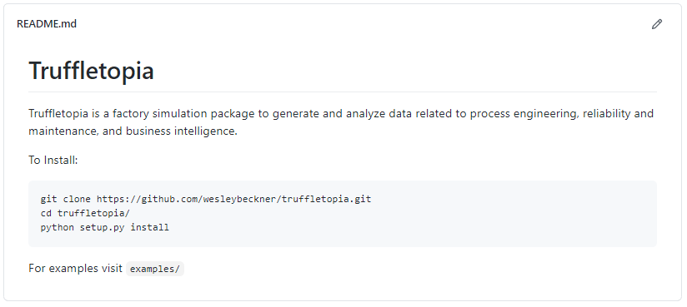
Readme
https://www.makeareadme.com/

Slide 7
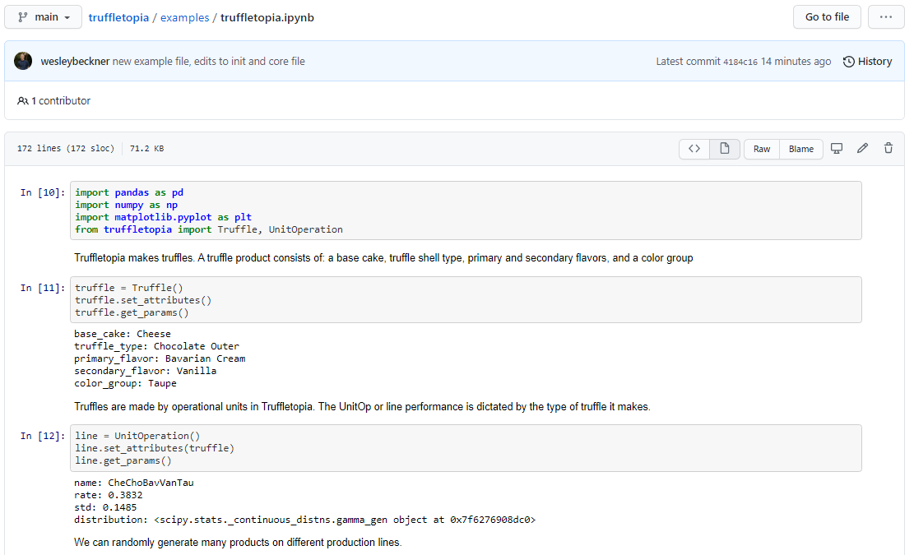
examples

Slide 8
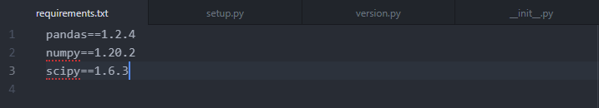
requirements.txt
https://docs.python-guide.org/writing/structure/#requirements-file
pip freeze > requirements.txt

Slide 9
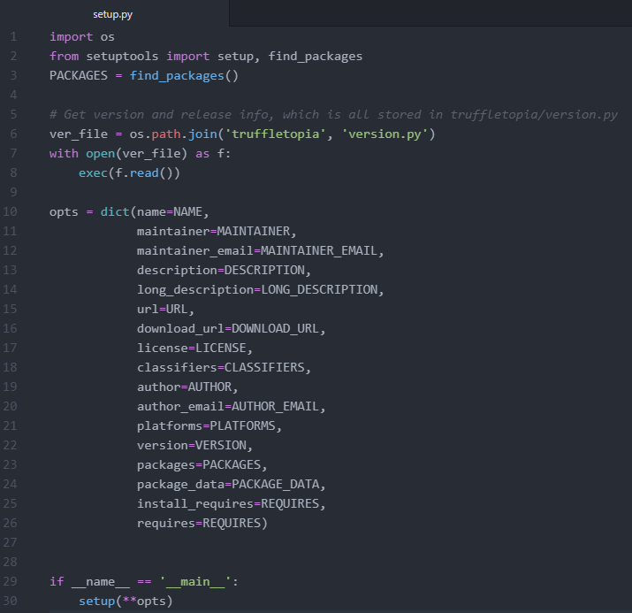
setup.py
https://docs.python-guide.org/writing/structure/#setup-py

Slide 10
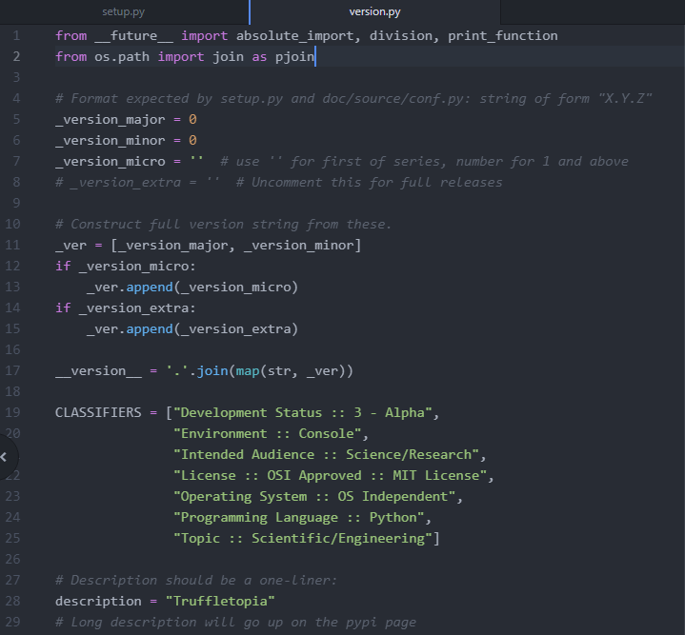
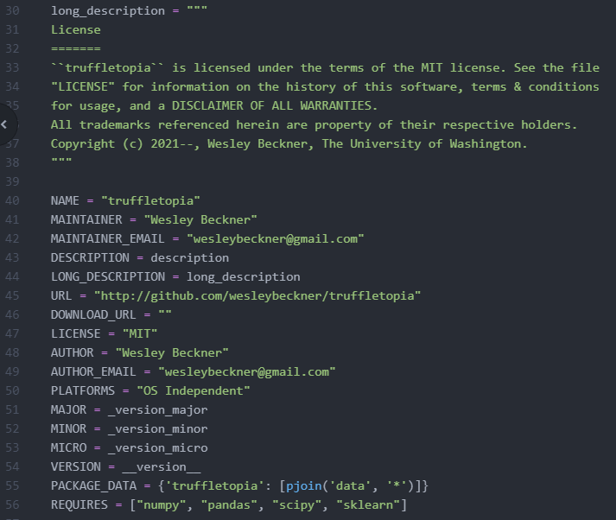
version.py

Slide 11
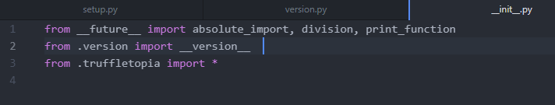
__init__.py
https://realpython.com/lessons/package-initialization/

Slide 12
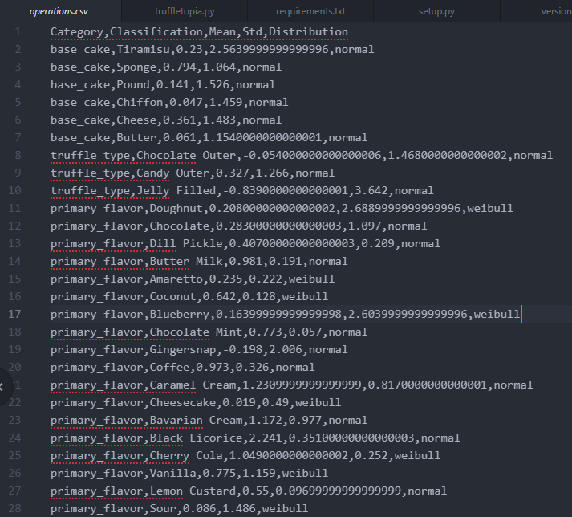
├── data
├──<datafile>.<fileext>

Slide 13
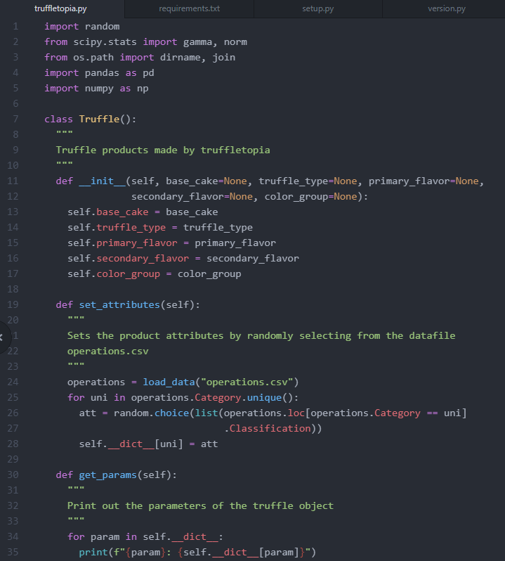
<package>.py

Slide 14
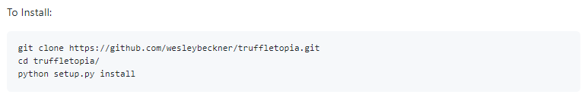
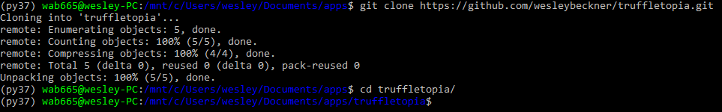
Installing and Testing
Command line demo

Slide 15
Let’s start Lab 2 Part 2 if time before lunch!!!

